Slide 1


Design of a Rental Management System with Analytics Dashboard for
Data-Driven Decision Making
Thesis Proposal
Shofa Yasmin Fauziah
225152011406
Computer Science
Shenyang Aerospace University
2026
Thesis Proposal | March 2026

Slide 2

Contents
Thesis Proposal | March 2026
1
Introduction
Background
Problem Statement
Research Objectives
Scope and Limitation
3
System and Data
System Overview
System Gap
Proposed Solution
Data Description
Data Flow
Dashboard Output
Methodology
Technology
Expected Result
Contribution
Closing
2
Literature Review
House Rental Management System
Exploratory Data Analysis (EDA)
Decision Support System (DSS)
Key Performance Indicators (KPI)
Timeline

Slide 3
Thesis Proposal | March 2026
1
Introduction

Slide 4
Background
1
2
3
Rental management systems are widely used to:
Manage properties
Handle transactions
Existing systems only focus on:
data storage & management
However:
Data is not used for analysis
No insights decision making
Result:
Users cannot understand system performance, the system only stores data without analysis
Thesis Proposal | March 2026
In this study, rental data is obtained from a public dataset (Kaggle)

Slide 5
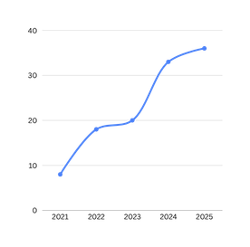
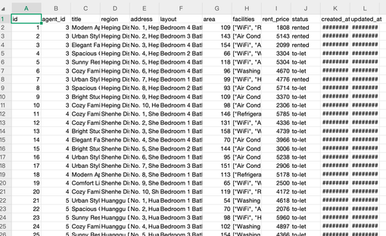
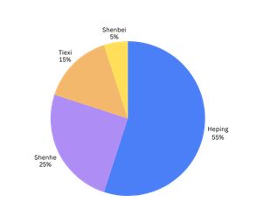
From raw data
Not useful yet
Into meaningful data that can be used for decision making

Slide 6
Problem Statement
Thesis Proposal | March 2026
1 The system currently cannot:
2 Even though:
Identify high-performing properties
Analyze demand trends by region
Evaluate rental pricing effectiveness
Not transformed into insights,
Not useful yet
“Data available but not useful”

Slide 7
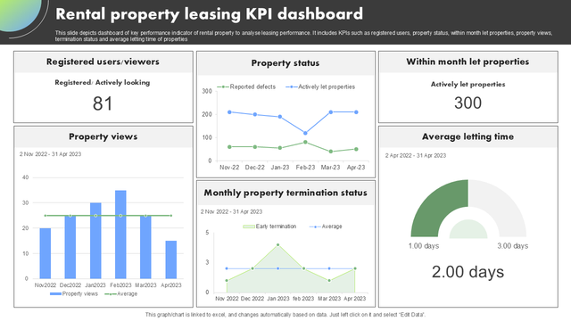
Research Objectives
This research aims to:
Develop an analytics dashboard
Apply EDA to rental data
Generate KPIs and visual insights
Support data-driven decision making
Example
Thesis Proposal | March 2026

Slide 8
Scope and Limitation
Thesis Proposal | March 2026
Focus only on:
Analytics Dashboard
System:
Existing system reused
Method:
Exploratory Data Analysis (EDA)
User:
Admin only
Data:
Rental dataset (Kaggle)

Slide 9
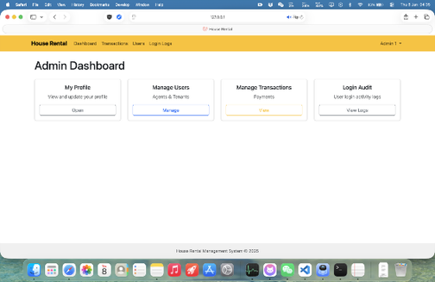
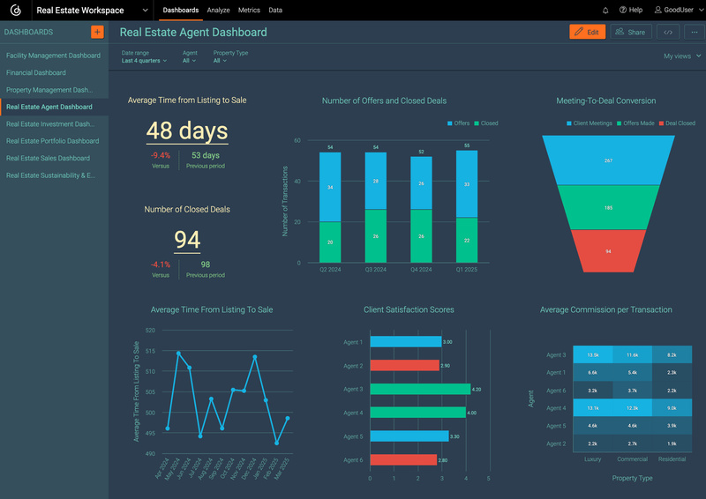
Admin Dashboard
Example of adding dashboard analytics

Slide 10
Thesis Proposal | March 2026
2
LITERATURE REVIEW

Slide 11
1
House Rental Management System
Thesis Proposal | March 2026
A rental management system is an information system designed to:
Manage property listings, tenants, and rental transactions
Support multi-role interaction (tenant, agent, and administrator)
Key Contribution:
Provides structured and centralized data management
Ensures organized handling of rental processes
Relevance to This Research:
Serves as a platform to store and manage rental data
Supports data processing and visualization through an analytics dashboard

Slide 12
2
Exploratory Data Analysis (EDA)
EDA is a data analysis approach used to:
Techniques:
Suitable for:
Statistical summary
Visualization (charts)
Understanding behavior
Not prediction
Understand data structure
Identify patterns and trends
Detect anomalies
Thesis Proposal | March 2026
analysis → insight

Slide 13
3
Decision Support System (DSS)
Thesis Proposal | March 2026
DSS is a system that:
Key Idea:
Assists decision making
Uses data + analysis
Not replacing humans
Supporting decisions
In this research:
Dashboard = DSS component
“operational system” → “strategic system”

Slide 14
4
DATA VISUALIZATION
Data visualization is the process of transforming data into graphical representations such as charts and graphs.
Purpose:
In this study:
Benefits:
Converts data into graphical form
Helps users understand complex data
Helps users interpret data more easily
Supports data-driven decision making
Rental data is visualized using charts
Supports analysis of:
rental trends
demand by region
property performance

Slide 15
5
Key Performance Indicators (KPI)
KPIs are measurable metrics used to evaluate performance.
In this system:
Total Rentals
Average Rent Price
Average Time to Rent
Occupancy Rate
Function:
summarize large data into simple indicators
Thesis Proposal | March 2026

Slide 16
Thesis Proposal | March 2026
3
SYSTEM
&
DATA

Slide 17
1
System Overview
Web-based house rental system
Supports:
Tenant : browse properties and submit rental requests
Agent : manage property listings and handle requests
Admin : monitor system activities
Thesis Proposal | March 2026
The system manages rental data and supports operational processes.

Slide 18
2
System Gap
Although the system manages rental operations effectively:
It does not provide analytical features
It cannot transform data into meaningful insights
It lacks data visualization for decision making
Thesis Proposal | March 2026

Slide 19
3
Proposed Solution
To address these limitations, this study proposes:
An analytics dashboard
Application of Exploratory Data Analysis (EDA)
Visualization of rental data using charts and KPIs
The system transforms raw data into meaningful insights.

Slide 20
4
Data Description
Rental data is used to support analysis, including:
Rental price
Property region
Rental date
Transaction data
The data is processed to generate KPIs and visual insights.
Thesis Proposal | March 2026

Slide 21
5
Data Flow
1
2
Dataset
Data Cleaning & Preparation
4
3
Dashboard
(EDA + KPI + Charts)
Database (System)
Thesis Proposal | March 2026
The dataset is first cleaned and prepared, then stored in the system database. The data is processed using EDA to generate KPIs and visualizations, which are displayed in the analytics dashboard

Slide 22
6
Dashboard Output
The dashboard presents:
Key Performance Indicators (KPIs):
Total rentals
Average rent price
Occupancy rate
Visualizations:
Rental trends
Demand by region
Property performance
Thesis Proposal | March 2026

Slide 23
7
Methodology
The Waterfall model is applied to develop the analytics dashboard as an enhancement to the existing system.
Stages:
Requirement Analysis
System Design
Implementation
Testing
Reason:
Structured and sequential process
Suitable for clearly defined system requirements
Thesis Proposal | March 2026

Slide 24
8
Technology
The system is developed using the following technologies:
Laravel : Used as the backend framework to handle system logic and data processing
MySQL : Used as the database to store rental data and system information
Chart.js : Used to visualize data in the form of charts within the dashboard
These technologies are integrated to support data processing and visualization in the analytics dashboard
Thesis Proposal | March 2026

Slide 25
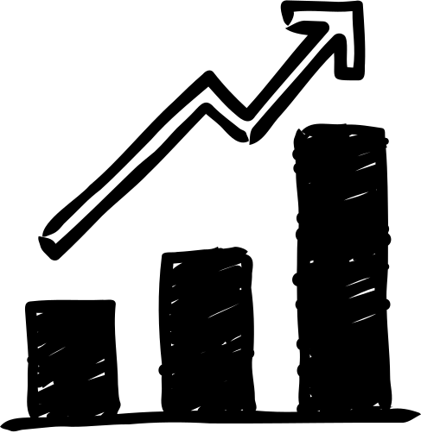
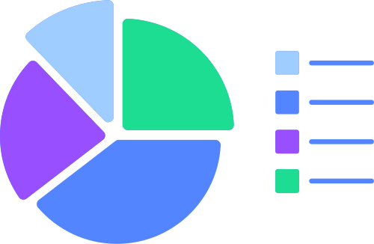
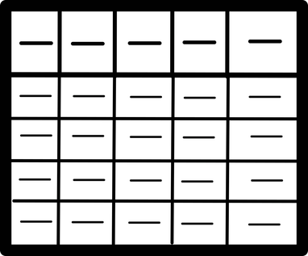

9
Expected Results
The proposed system is expected to:
Provide a clear and interactive analytics dashboard
Transform rental data into meaningful insights
Help users understand rental performance and trends
Transformation
Thesis Proposal | March 2026
Data is analyzed and presented as insights
Data is only stored

Slide 26
10
Contribution
This research contributes by:
Enhancing an existing rental management system with analytics features
Applying Exploratory Data Analysis (EDA) to rental data
Presenting data through KPIs and visualizations
Supporting data-driven decision making
Thesis Proposal | March 2026

Slide 27
11
Closing
Conclusion
Data alone is not sufficient for decision making
Data analysis is necessary to extract meaningful insights
The analytics dashboard bridges the gap between raw data and decision making
This study demonstrates how data can be transformed into actionable insights through visualization.
Thesis Proposal | March 2026

Slide 28
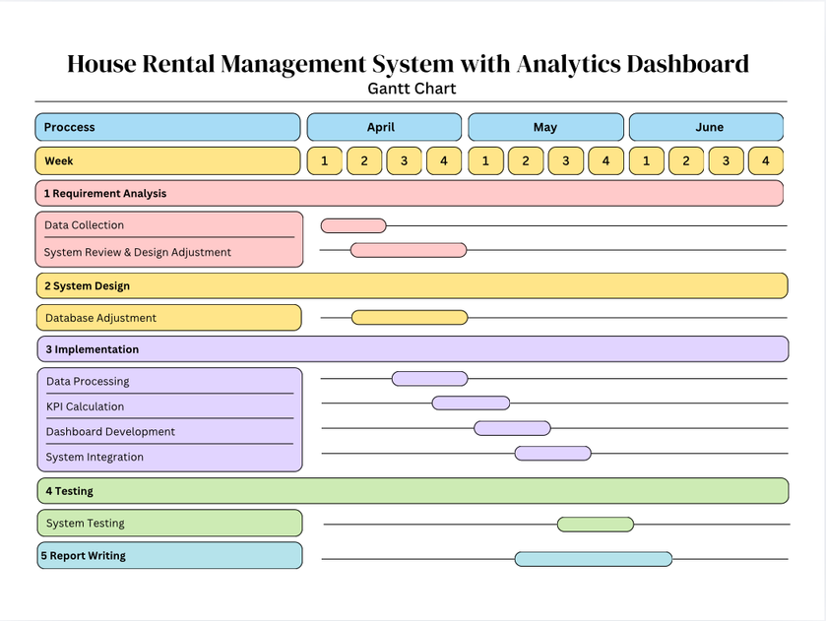
Timeline
Thesis Proposal | March 2026

Slide 29
Thesis Proposal | March 2026
Thank you!
Let me know if you have questions or
need clarifications.

